Slide 1
Character
Understanding
Literary
Terms
Antagonist / Protagonist
Dynamic / Static
Direct / Indirect
© Presto Plans

Slide 2
The Importance
Of Character
- Characters help the reader relate to and connect with the story.
Characters drive the plot.
Characters teach the reader about the human condition.
© Presto Plans

Slide 3
Types of Character
Protagonist
Antagonist
Static (Flat)
Dynamic (Round)
Stock
© Presto Plans

Slide 4
Protagonist
The protagonist is the leading character or one of the major characters in a drama, movie, novel, or other fictional text. Protagonists often play the role of the hero or heroine.
© Presto Plans

Slide 5
Antagonist
The antagonist opposes, struggles against or competes with the protagonist. They often play the role of the villain.
© Presto Plans

Slide 6
Examples:
Click the image below to see an example of
protagonist vs antagonist
Click Here!
© Presto Plans

Slide 7
Static (Flat)
A static or flat character is one who is not complex and only has one or two basic qualities. A static character undergoes little or no inner change and does not develop as the story progresses.
Click the image to see an example of a static character.
© Presto Plans

Slide 8
Static (Flat)
Sheldon is an intelligent Theoretical Physicist who adheres strictly to routine, lacks social skills or empathy, and is narcissistic. Although he
sometimes steps outside
of this role, he always
reverts back to his
"normal" self unchanged.
This makes him a static
or flat character.
© Presto Plans

Slide 9
Dynamic (Round)
A dynamic or round character is one who is complex and multi-dimensional. A dynamic character undergoes an important inner change, usually in personality or attitude.
Click the image to see an example of a dynamic character.
© Presto Plans

Slide 10
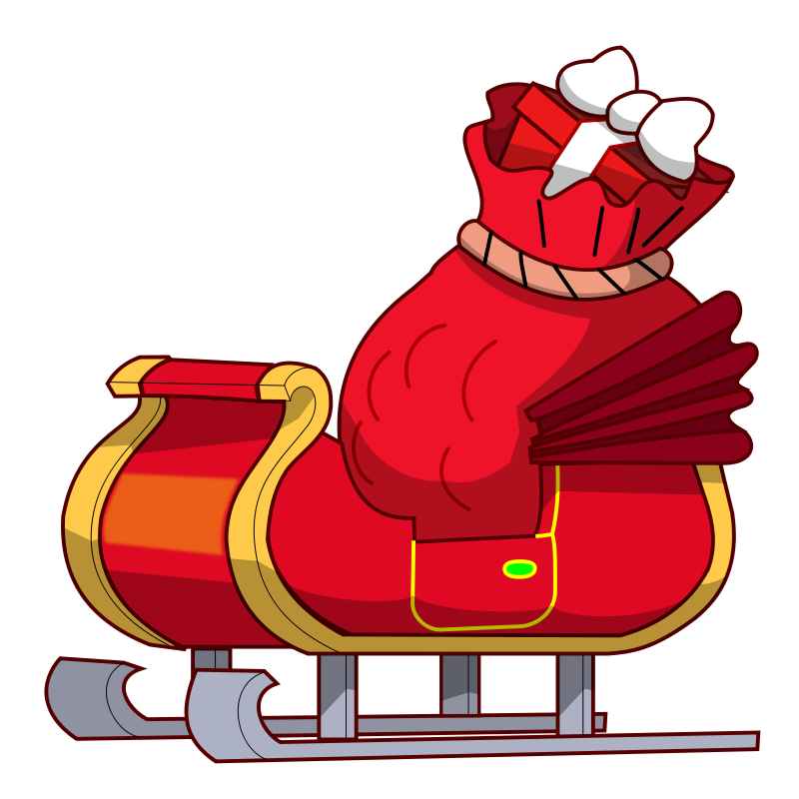
Dynamic (Round)
The Grinch starts out as a miserable Christmas hating character, but changes to be more caring and giving. This makes him a dynamic round character.
© Presto Plans

Slide 11
Stock Character
A stock character is a stereotypical fictional character that the reader will recognize from frequent recurrences in other works. Stock characters are always flat/static as they only possess one or two stereotypical traits.
Click the image to see an example of a stock character.
Watch until 1:40
© Presto Plans

Slide 12
Stock Character
In this clip, Biff is a stock character. His role is one that would be recognizable to the audience– he is the stereotypical bully. He is bigger than the other characters, picks on others who are smaller than him, and he lacks intelligence.
© Presto Plans

Slide 13
Characterization
Characterization is the process by which the author reveals the personality of the characters in a fictional story. There are two types of characterizations: Direct & Indirect.
© Presto Plans

Slide 14
Direct
Direct characterization occurs when the writer directly TELLS the audience what the personality of the character is.
The character is…
Tall
Angry
Smart
Nice
Impatient
Nervous
Witty
© Presto Plans

Slide 15
Direct: Example
“John was an intelligent and quick-witted student”
The author directly tells the reader about John’s personality traits.
© Presto Plans

Slide 16
Indirect
Indirect characterization occurs when the writer indirectly REVEALS the personality of the characters by SHOWING the reader.
© Presto Plans

Slide 17
Indirect: Example
“Susan was not looking forward to wearing a frilly dress to the dance. It simply wasn’t her”
The author does not tell the reader anything directly about Susan, but his words show that Susan may be a tomboy.
© Presto Plans

Slide 18
Indirect: Activity
1. Think of a word you would use to describe yourself.
2. Write an example of you demonstrating that quality. For example, if you chose the word “neat freak”, you might write “Everyday I pick up, dust, and vacuum my room.”
The sentence you wrote is an example of indirect characterization. You don’t TELL us about what quality you have, but instead you SHOW us!
© Presto Plans

Slide 19
STEAL Method
There are five different ways that an author can indirectly reveal the personality of the characters. Use the STEAL method when analyzing character
STEAL
Speech
Thoughts
Effect on others
Actions
Looks
© Presto Plans

Slide 20
Speech
Consider what the character says and how they speak. What does this reveal about their personality? Consider the following examples:
A person who uses complex language may be intelligent or educated.
A person who talks a lot may be social, or nervous
A person who swears a lot may be angry, crude, or hot-tempered.
© Presto Plans

Slide 21
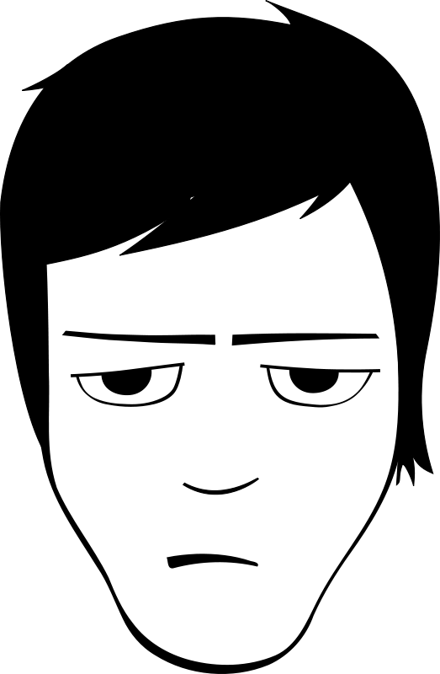
Thoughts
Consider what is revealed through the character’s private thoughts and feelings (if the narration provides this information)
John thought to himself that if he had to sit in class for one more minute he might explode. ‘When will this class end?’ he wondered.
For example…
John’s thoughts indirectly reveal he is impatient and has very little interest in school
© Presto Plans

Slide 22
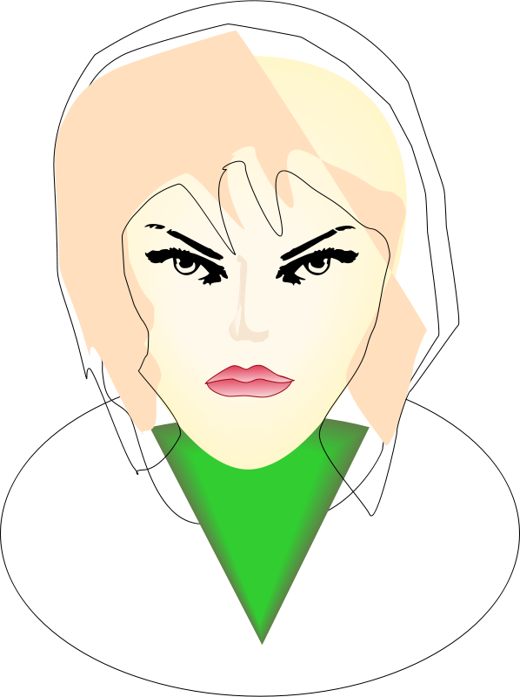
Effect On Others
Consider how other characters feel or act in reaction to the character. What does this reveal about their relationships with others?
The girl glared at her brother as she finished her dessert. He looked at her apologetically, but this only made her more angry
This passage reveals that the girl is furious with her brother for something he has done. It also shows she is hot-tempered and perhaps unforgiving.
© Presto Plans

Slide 23
Actions
Consider the character’s action. How do they behave and what do they do? What does this reveal about their personality? The actions of a character always reveal the true self.
She took a deep breath, smiled and let go of the airplane doors. The first 10 seconds were a rush she had never felt before. She pulled the handle and the chute opened.
This passage reveals that the woman is a fearless risk-taker. Her actions and attitude show she gets a thrill from dangerous activities.
© Presto Plans

Slide 24
Looks
A character’s appearance can reveal information about a person, but it can sometimes be deceptive as it may be used to mask their true self. Consider the character’s expression, body language, and dress. What does this reveal about their personality?
The little girl, covered in dirt, left the game with slumped shoulders and a frown on her face. She knew it was over.
The girl’s body language shows that she is disappointed with her or her team’s performance. It also suggests that she is a competitive person.
© Presto Plans

Slide 25
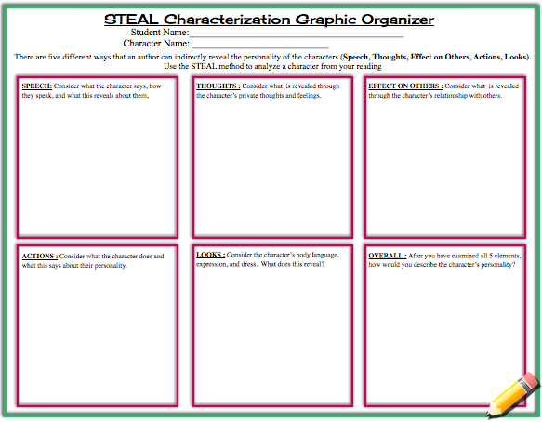
Your Turn
Complete your own character analysis! Look at how the author directly and indirectly reveals information about the character’s personality. Make sure to read between the lines by using the STEAL method!
© Presto Plans

Slide 26
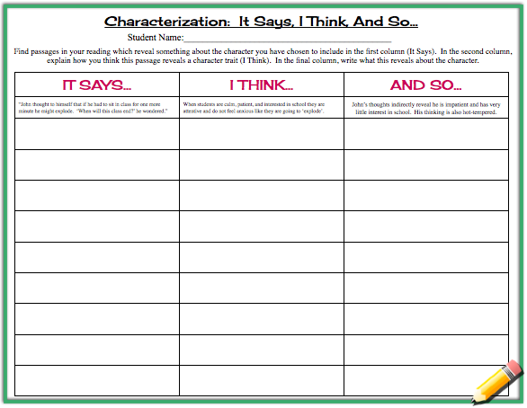
Your Turn
Try the “It Says, I Think, And So” activity to dig deeper into specific quotations about the character. Pull out passages, look at them closely, and determine what kinds of indirect characterization the author is trying to develop.
© Presto Plans

Slide 27
Fonts Not Appearing Correctly?
Install the following font to your computer and reopen this presentation.
http://www.fontspace.com/font-diner/cherry-cream-soda
© Presto Plans

Slide 28
The original purchaser of this document is granted permission to copy for teaching purposes only. If you are NOT the original purchaser, please download the item from my store before making any copies. Redistributing, editing, selling, or posting this item or any part thereof on the Internet are strictly prohibited without first gaining permission from the author. Violations are subject to the penalties of the Digital Millennium Copyright Act. Please contact me at prestoplans@gmail.com if you wish you be granted special permission
You can visit my store at
http://www.teacherspayteachers.com/Store/Presto-Plans
© Presto Plans

